Slide 1
Swift Day 02

Slide 2
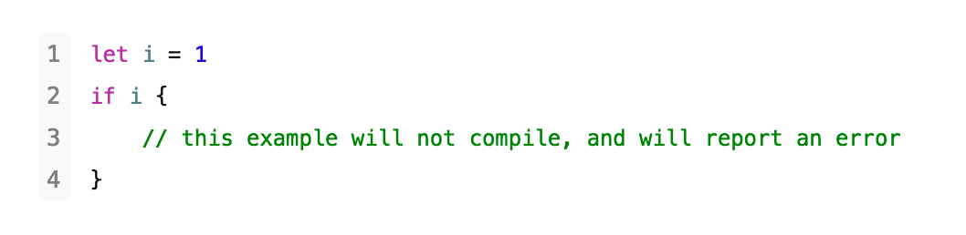
Logic type
Bool: true, false
In Swift: true is true, not “1”. False is the same.

Slide 3
Basic
Remainder: Int, Floating-point: 8.5 % 4 = 0.5

Slide 4
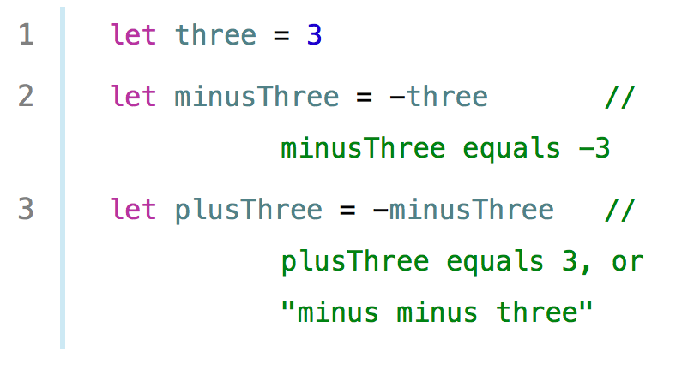
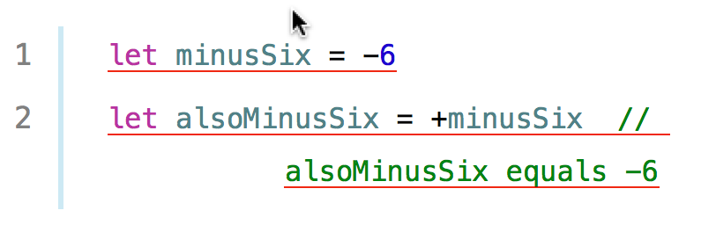

Basic
unary minus operator (-):
unary plus operator (+):

Slide 5

Basic
Nil Coalescing Operator: a ?? b =
let b: String = “1”
var a: String?
let c = a ?? b
=> c = ?

Slide 6
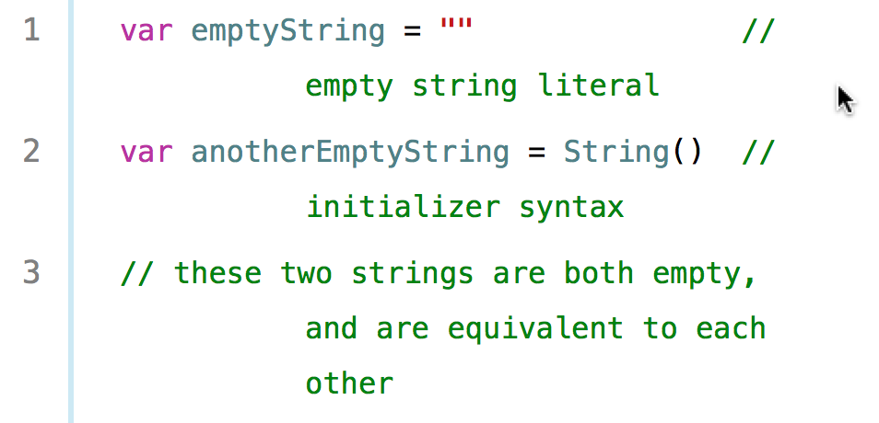
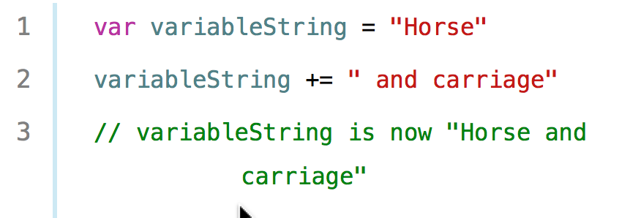
String and Character

Slide 7

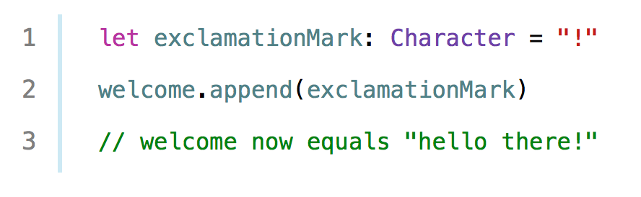
String and Character
Declare Character:
Append character to string:

Slide 8
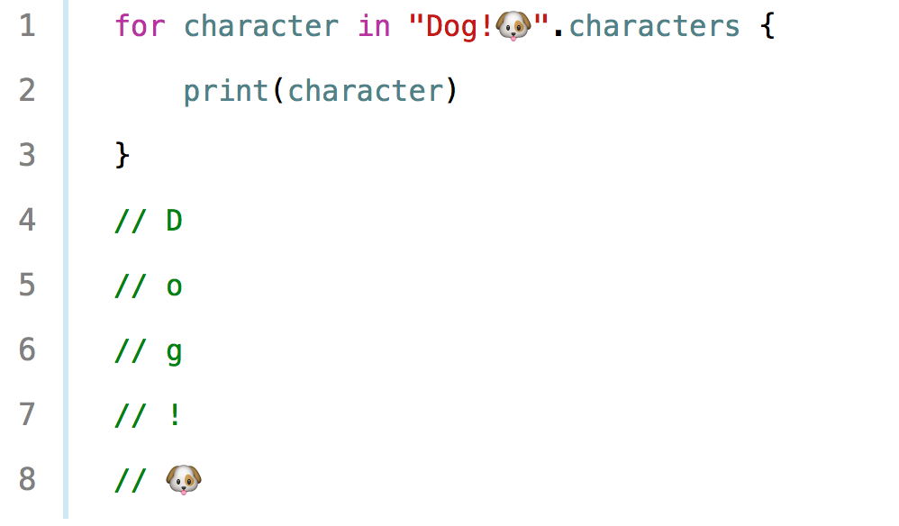
String and Character
String to Character:

Slide 9
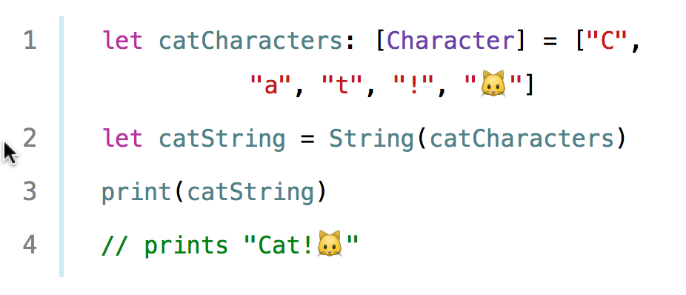
String and Character
String from Character:

Slide 10
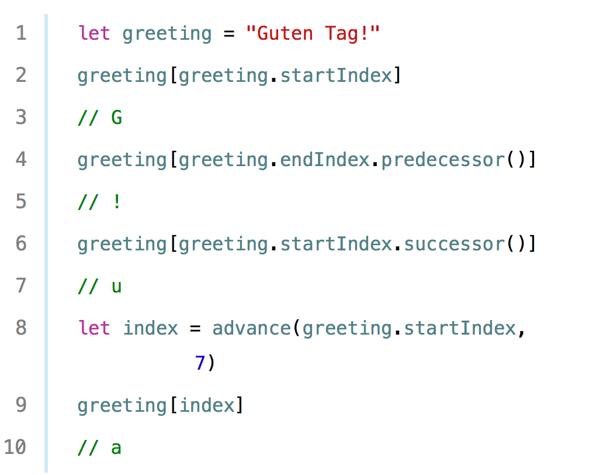
String and Character
Access String:

Slide 11
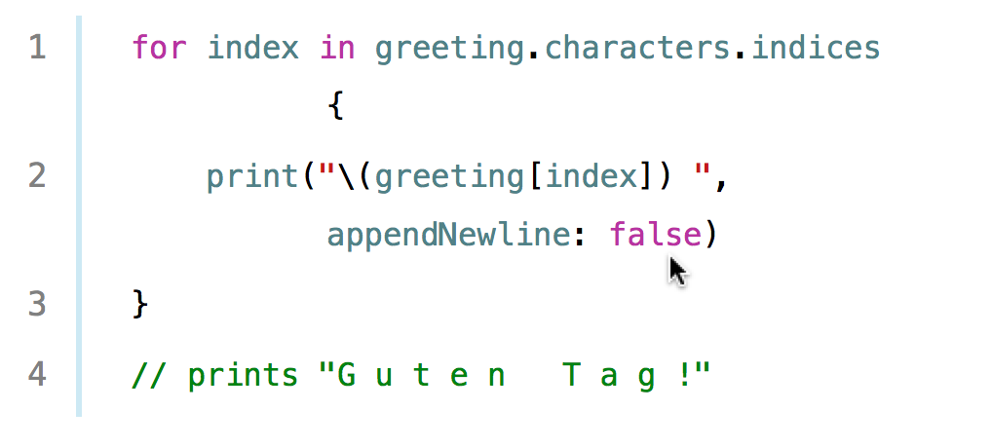
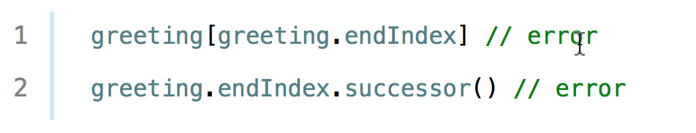
String and Character
Access String:
Error:

Slide 12
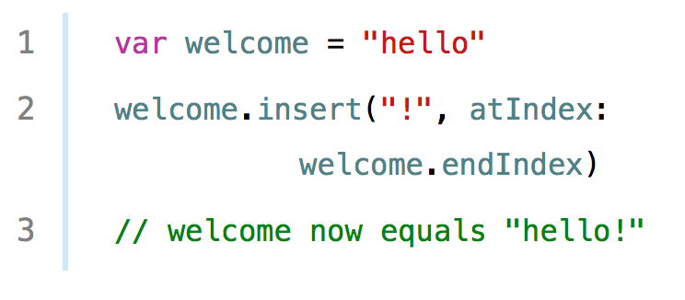
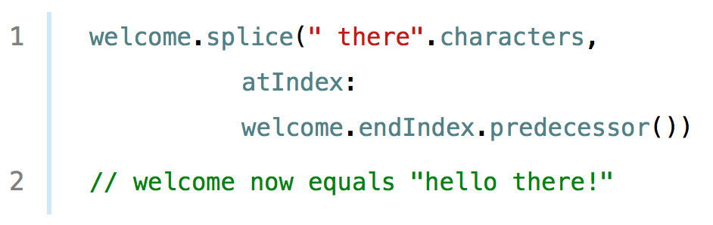
String and Character
Insert Character:
Insert String:

Slide 13
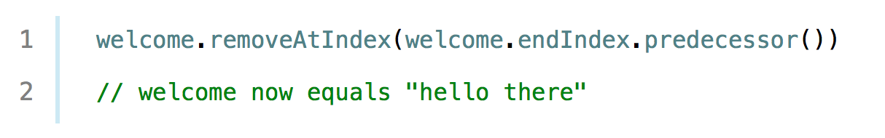
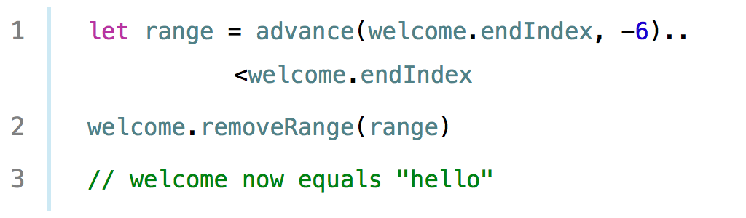
String and Character
Remove Character:
Remove String in Range:

Slide 14
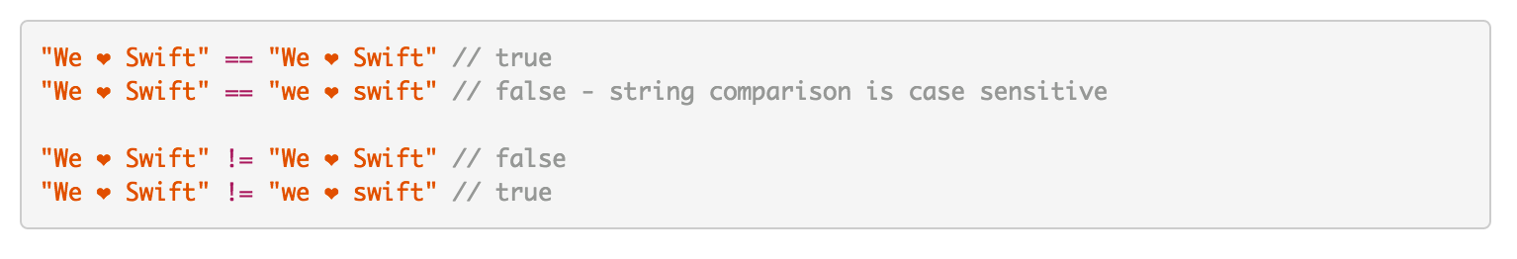
String and Character
Compare String:

Slide 15
String and Character
String Unicode: refer Apple Document

Slide 16
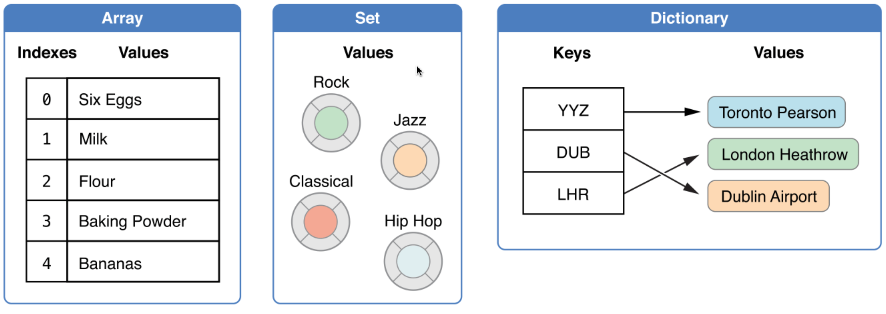
Collection Types

Slide 17

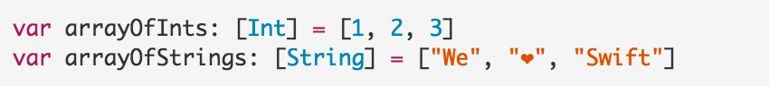
Array
Declare Array:

Slide 18
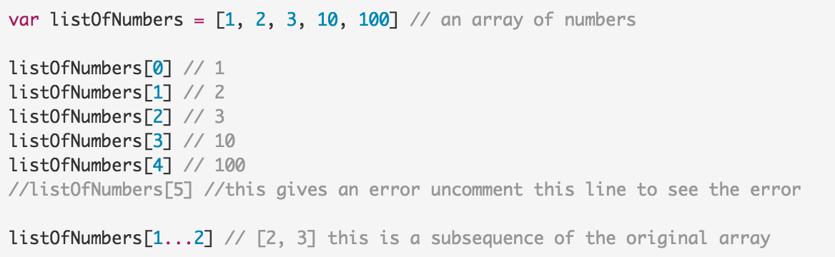
Array
Access Values:

Slide 19
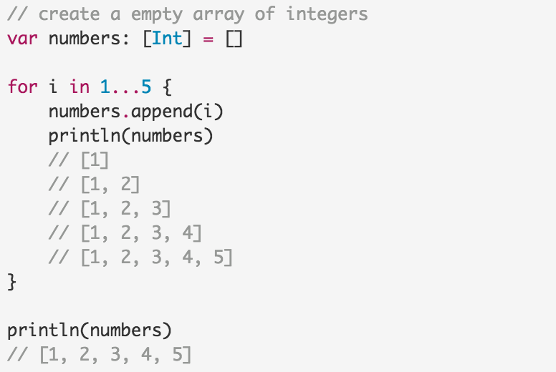
Array
Insert Values:

Slide 20
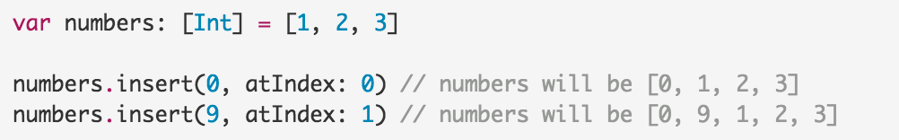
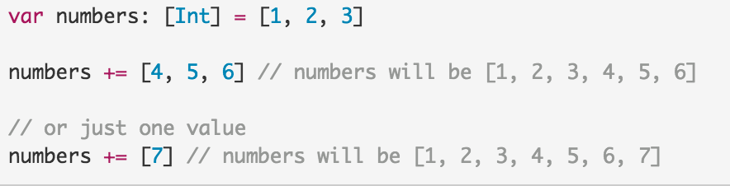
Array
Insert Values:

Slide 21
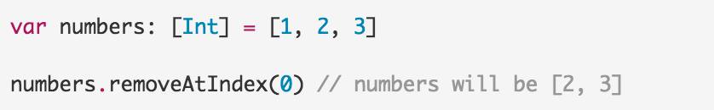
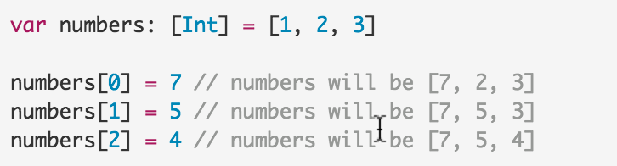
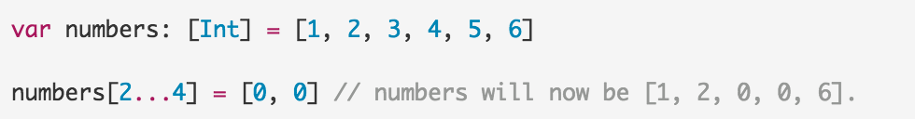
Array
Remove Values:
Update Values:

Slide 22
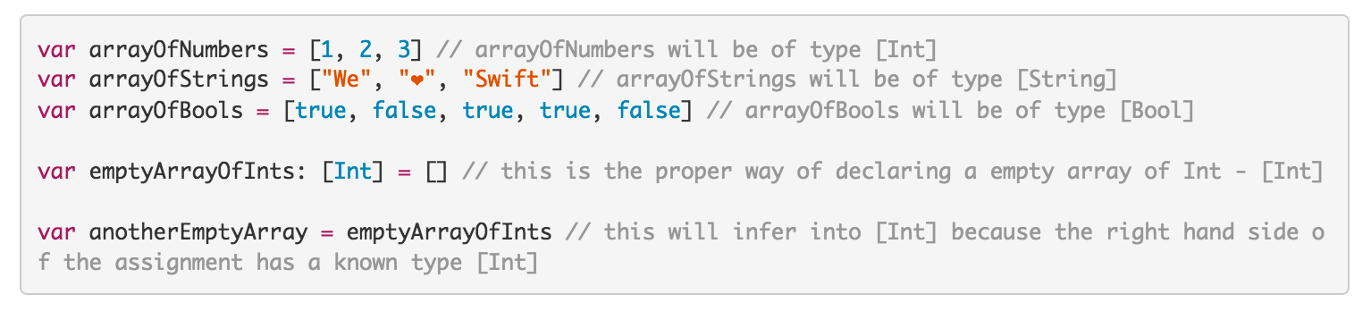
Array
Types Reference:

Slide 23
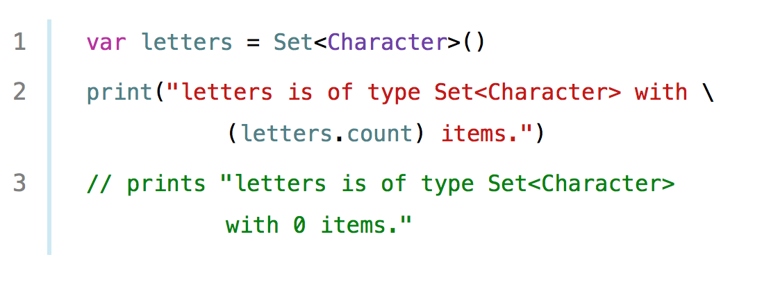
Set
Declare Set:

Slide 24
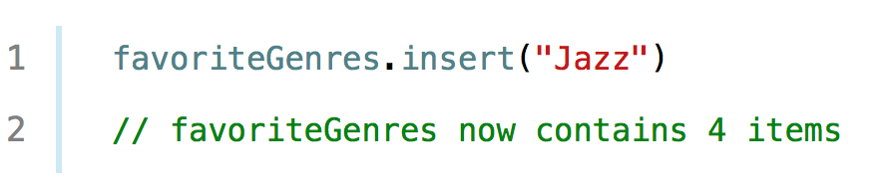
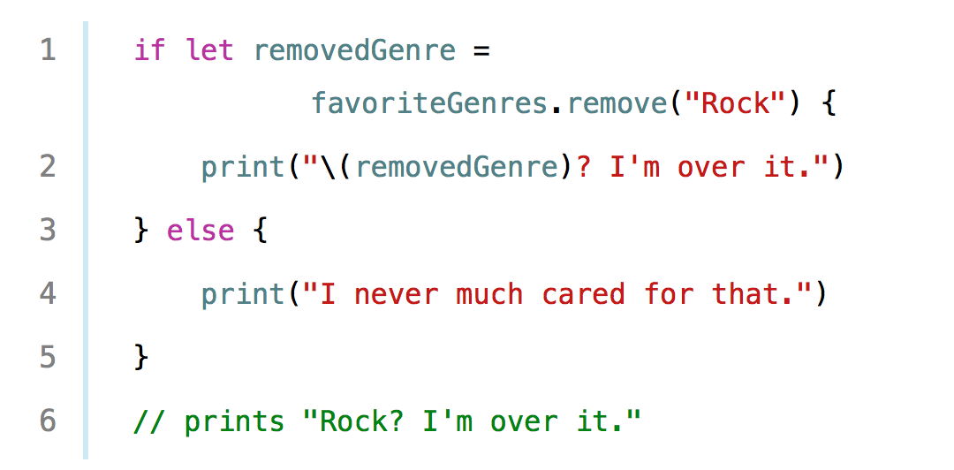
Set
Insert:
Remove:

Slide 25
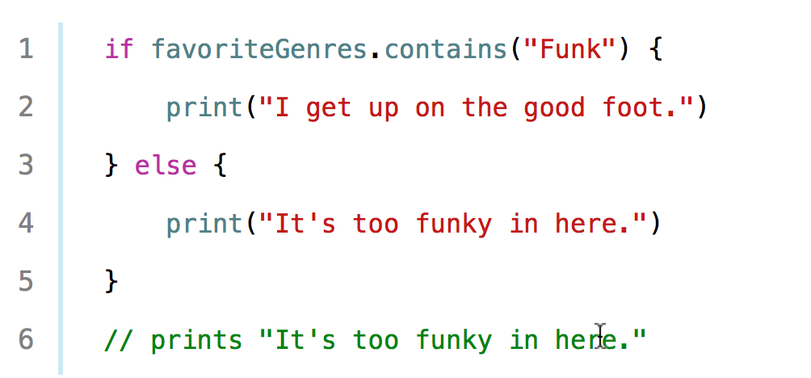
Set
Contain:

Slide 26
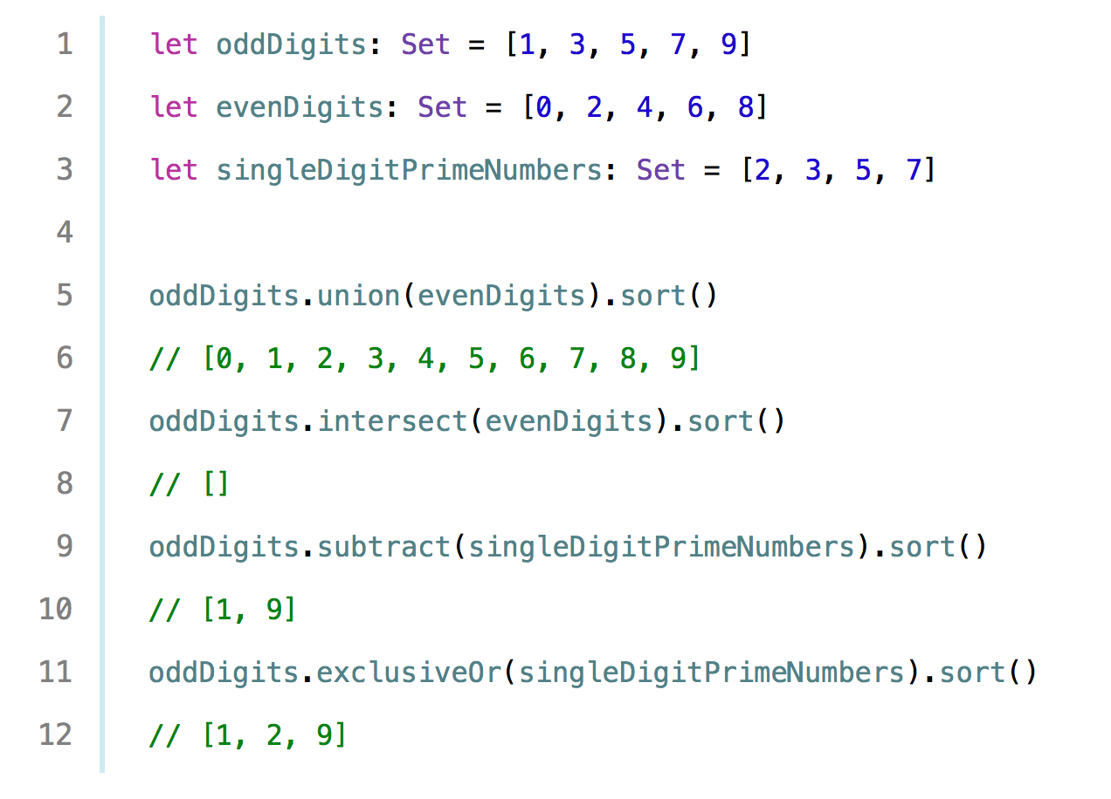
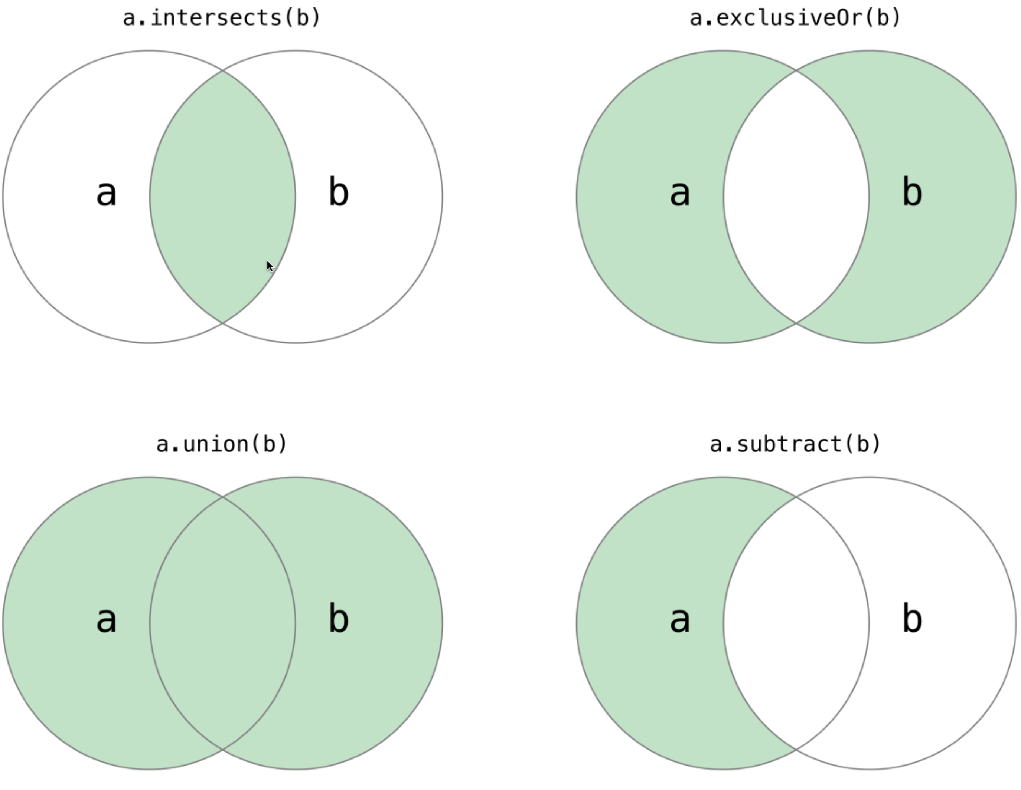
Set
Set Operation:

Slide 27
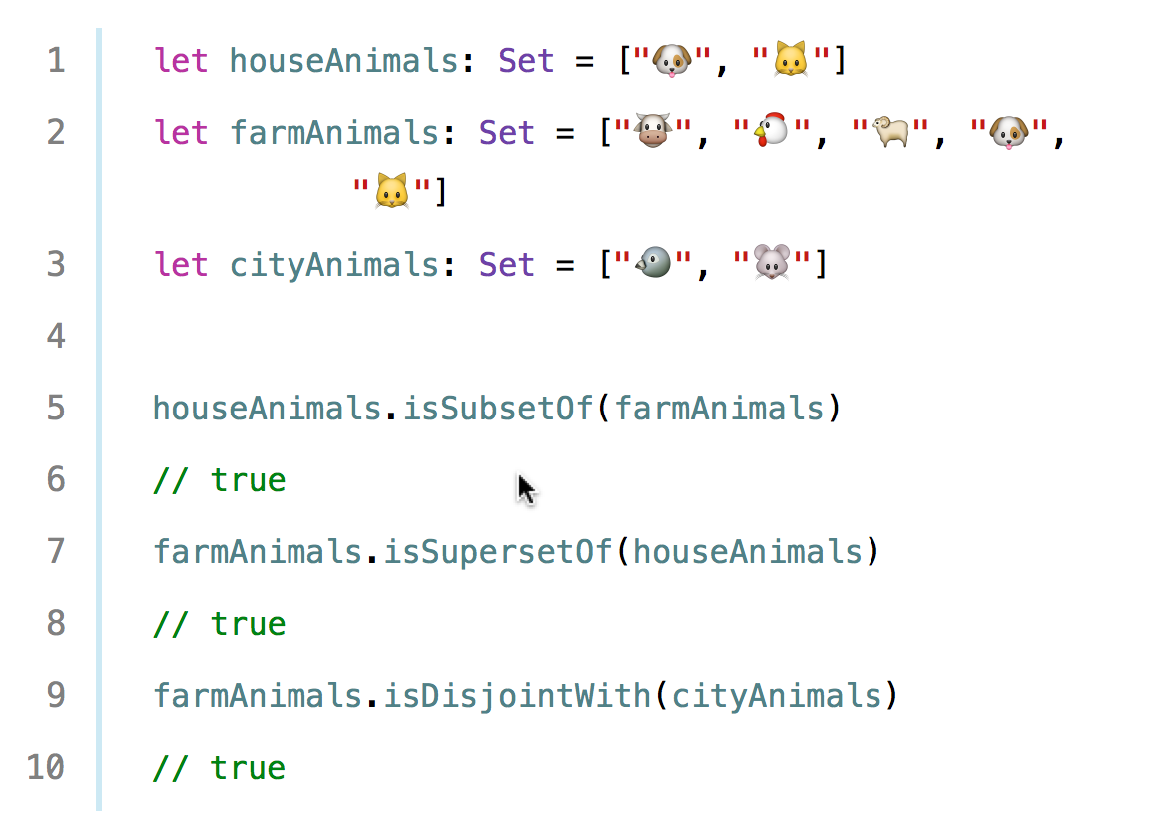
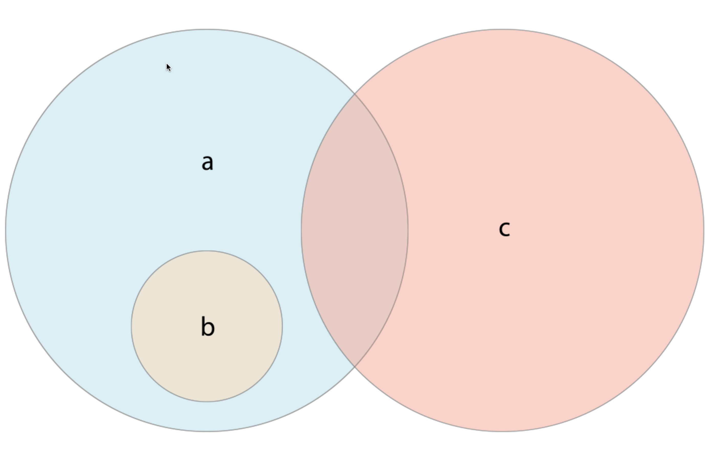
Set
Set compare:

Slide 28
Set
A == B: Set A isEqual set B?
isStrictSuperSet: isSuperSet but not equal (!=)?
isStrictSubSet: isSubSet but not equal (!=)?

Slide 29
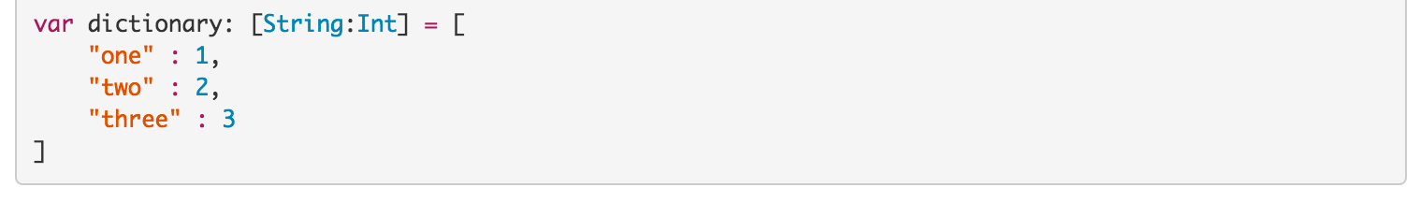
Dictionary
Declare Dictionary

Slide 30
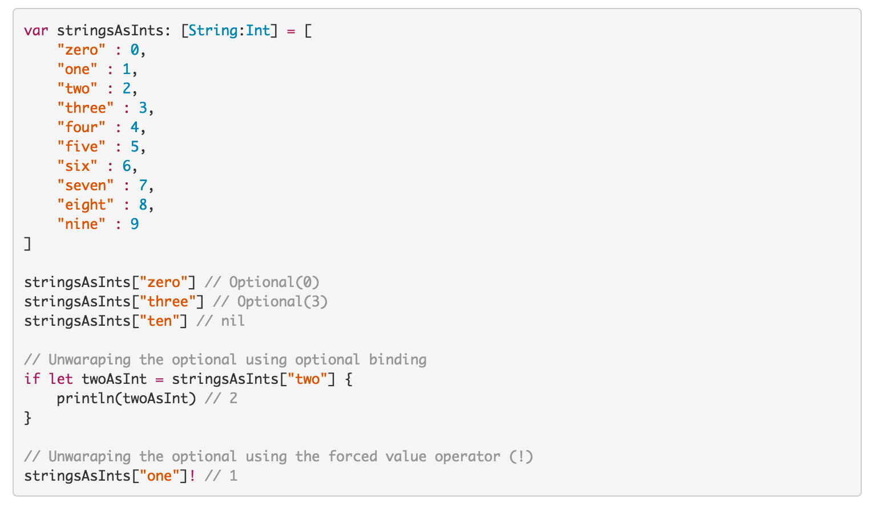
Dictionary
Access Values:

Slide 31
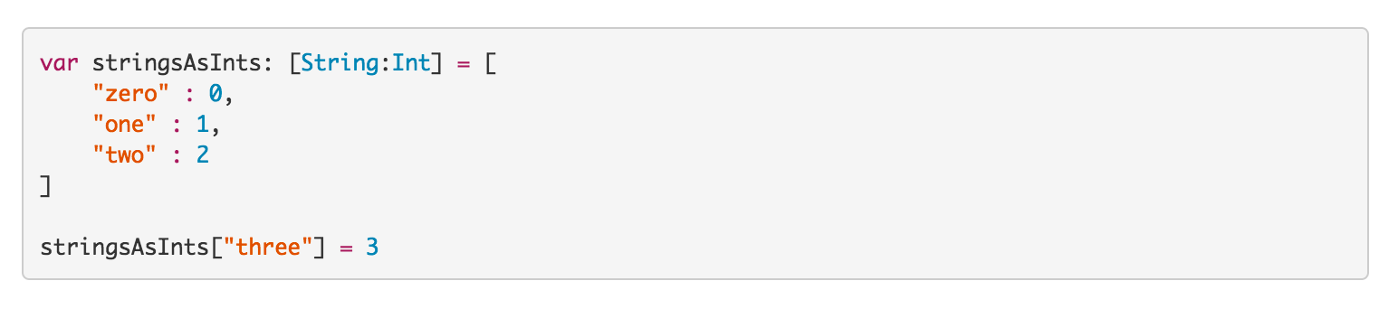
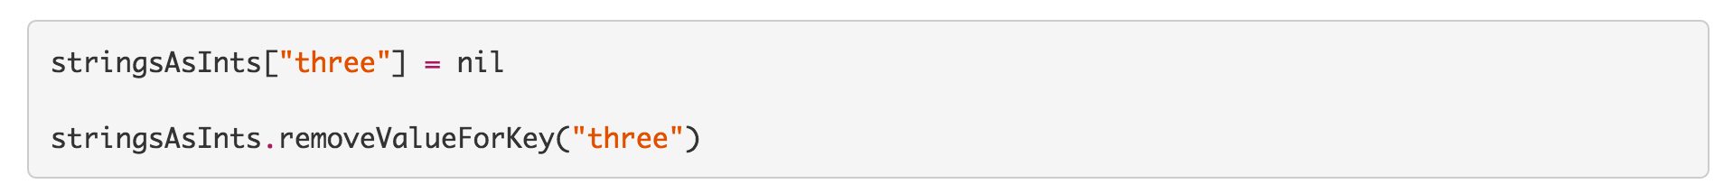
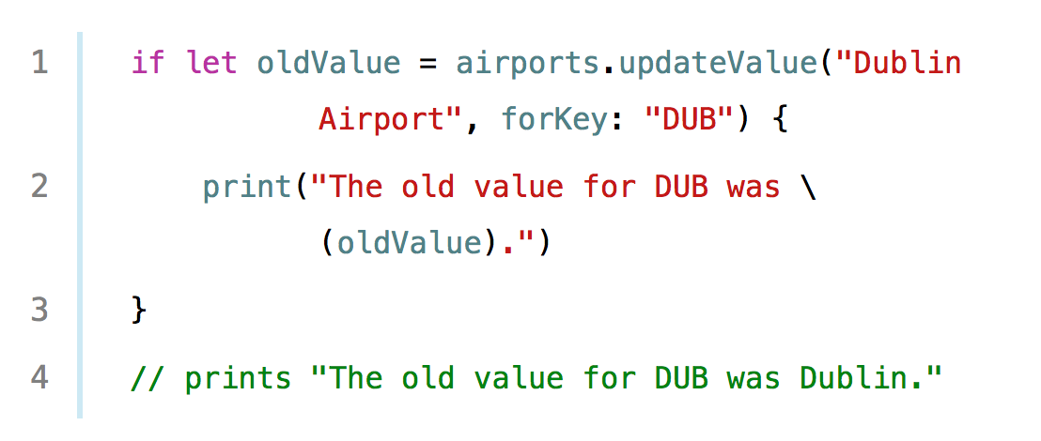
Dictionary
Change or Remove Values:

Slide 32
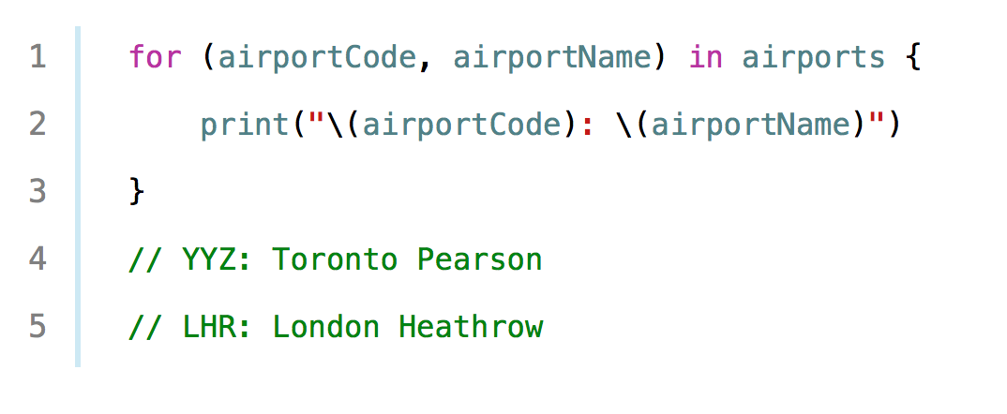
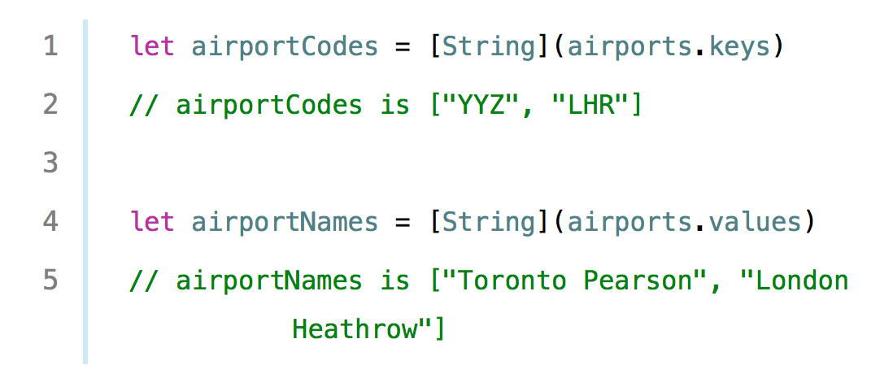
Dictionary
Iterative in dictionary:

Slide 33
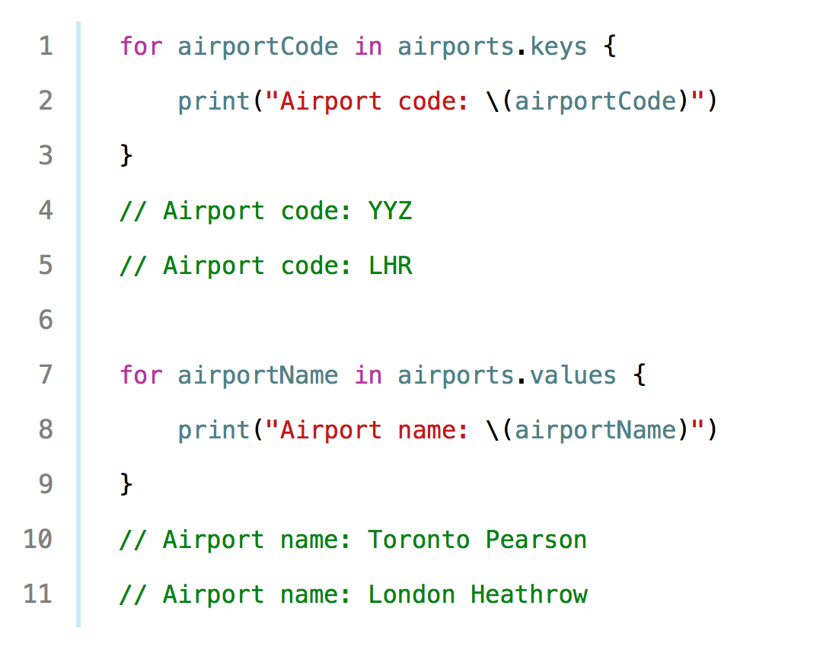
Dictionary
Iterative in dictionary:

Slide 34
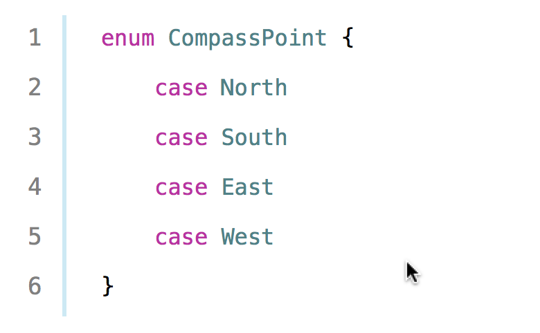
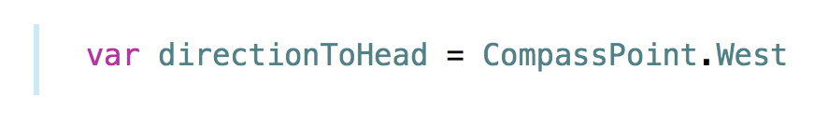

Enumeration
Declare Enum:

Slide 35
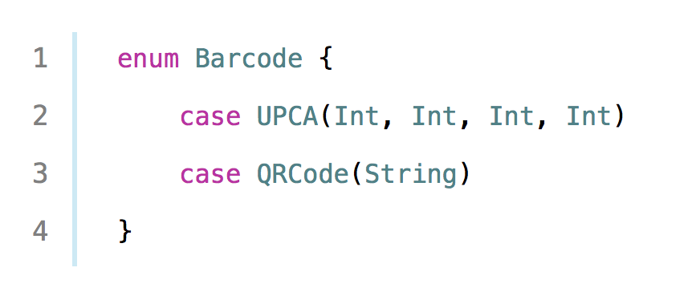
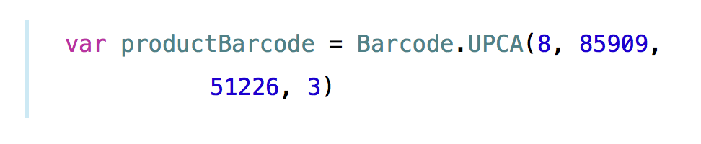

Enumeration
Associate Values:

Slide 36
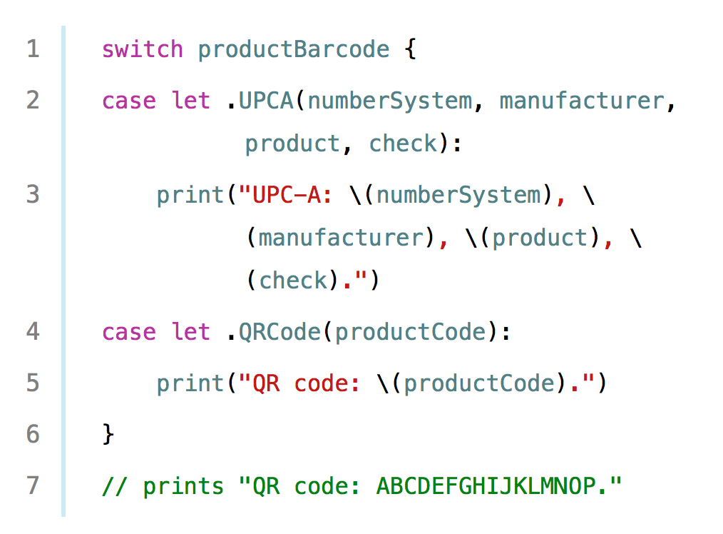
Enumeration
Associate Values:

Slide 37
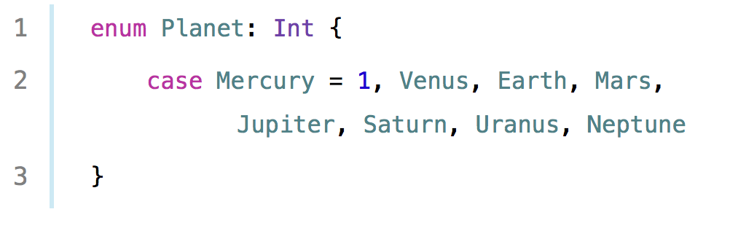
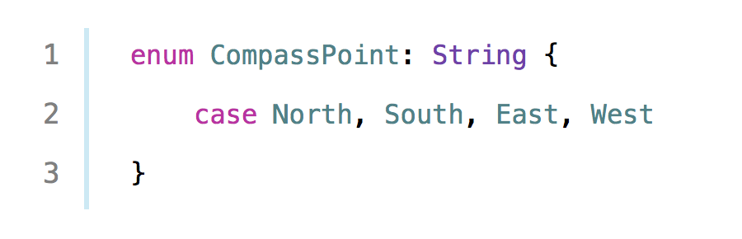
Enumeration
Raw value:

Slide 38
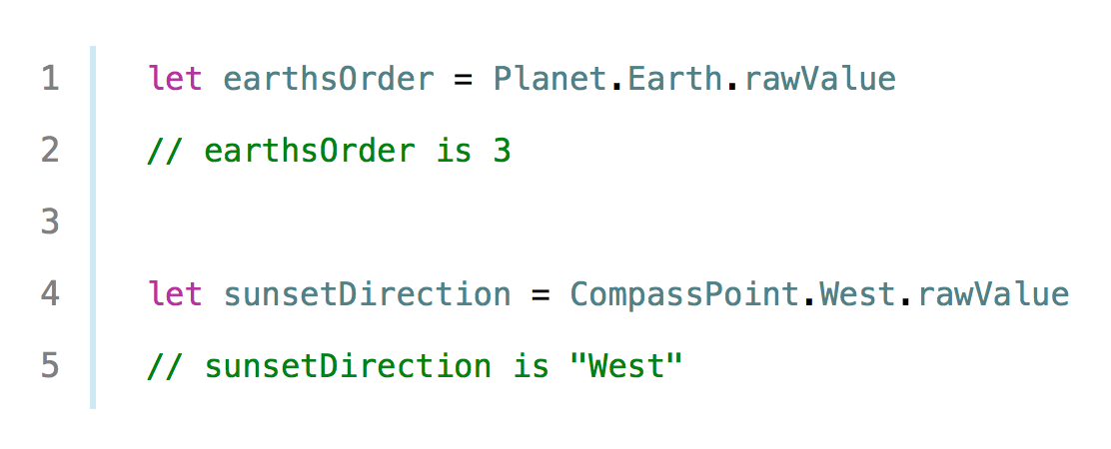

Enumeration
Raw value:

Slide 39

Enumeration
Recursive Enum:
See more: Apple Enumerations Document

Slide 40



Tuples
A tuple is a group of zero or more values represented as one value.
Create Tuples:

Slide 41

Tuples
In swift every variable or constant is a tuple :

Slide 42

Tuples
Decomposing Tuples:
The ”_” means “I don’t care about that value”.

Slide 43

Tuples
Returning multiple values:

Slide 44
Control flow
Control Flow
Condition
Loops
For
While
Repeat - While
If-else
Switch
Guard

Slide 45

Control Flow
Range:
Half-Closed Range: 1..<5

Slide 46

Switch Statement
No “fallthrough”, no need “break”:

Slide 47

Switch Statement
Use with Range:

Slide 48

Switch Statement
Use with Tuples:

Slide 49

Switch Statement
Binding values:

Slide 50

Switch Statement
Where statement:

Slide 51

Switch Statement
Fallthrough:

Slide 52

Control flow
Label Statement:

Slide 53
Control flow
Guard: new in Swift 2.0
Guard seem that is better than If-Else, special in using with Optional!

Slide 54
optional
Optional say either “there is a value, and it equals x” or “there isn’t a value at all”
The only way something can be nil in Swift is if it’s optional.
=>if something’s not declared as optional, it’s not nil.”.

Slide 55

optional
Unwrapping Optional

Slide 56

optional
Optional Binding

Slide 57
optional
Forced Unwrapping: Use it only when absolutely necessary and when you’re sure the optional cannot contain nil during that code’s execution.

Slide 58

optional
Implicitly Unwrapped Optional: Optional + Automatically unwrap+ won’t never be “nil”(you know).
=> Why use implicitly unwrapped Swift Optional ?

Slide 59
optional
Why use implicitly unwrapped Swift Optional ?
Implicitly unwrapped optional are useful in classes and structs where you won’t have a property’s value available in the initializer, but will have a value later before it is used.
Implicitly Unwrapped Optional is not safe.

Slide 60

Let vs Var
Mutable state is to avoid as much as possible. Use let when possible
Lazy let:

Slide 61
Reference
Basic:
http://oleb.net/blog/2014/07/swift-strings/
https://www.weheartswift.com/swift-programming-scratch-100-exercises/
Optional:
http://www.touch-code-magazine.com/swift-optionals-use-let/
http://www.appcoda.com/beginners-guide-optionals-swift/
http://roadfiresoftware.com/2014/12/wrap-your-head-around-optionals-in-swift/
http://www.reactive.io/tips/2015/03/02/understanding-optionals-in-swift/
Guard:
http://www.codingexplorer.com/the-guard-statement-in-swift-2/
http://austinzheng.com/2015/06/08/swift-2-control-flow/

